Slide 1
Starting Out with C++ From Control Structures Through Objects
Chapter 10

Slide 2
Chapter 10: Characters, C-Strings, and More About the string Class
10.1 Character Testing
10.2 Character Case Conversion
10.3 C-Strings
10.4 Library Functions for Working with C-Strings
10.5 C-String/Numeric Conversion Functions
10.7 More About C++ string Class

Slide 3
10.1 Character Testing
C++ library provides several functions that allow you to test the value of a character
These functions test a single char argument and return and int value, which indicates either true or false
Need new header file cctype
isalpha | Returns true (a nonzero number) if the argument is a letter of the alphabet, returns 0 if the argument is not a letter
isalnum | Returns true (a nonzero number) if the argument is a letter of the alphabet or a digit, returns 0 otherwise
isdigit | Returns true ( a nonzero number) if the argument is a digit from 0 to 9, otherwise returns 0
islower | Returns true (a nonzero number) if the argument is a lowercase letter, otherwise returns 0
isprint | Returns true (a nonzero number) if the argument is a printable character (including space). Otherwise returns 0
ispunct | Returns true (a nonzero number) if the argument is a printable character other than a digit, letter, or space. Returns 0 otherwise
isupper | Returns true (a nonzero number) if the argument is an uppercase letter, otherwise returns 0
isspace | Returns true (a nonzero number) if the argument is a whitespace character (space, newline, vertical tab, tab). Otherwise returns 0

Slide 4
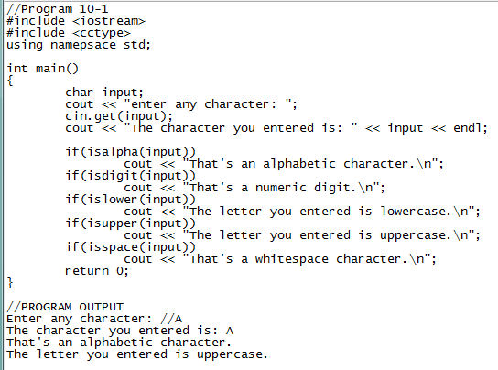
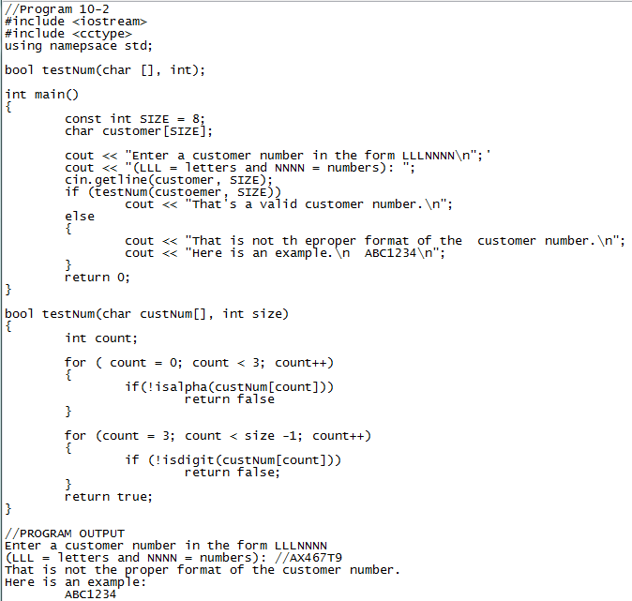
We use the negation operator in conjunction with the isalpha and isdigit function in order to determine the opposite, if the character was a letter, isalpha would return true but we are checking to see if it is not a letter

Slide 5
10.2 Character Case Conversion
The C++ library provides two functions, toupper and tolower, for converting the case of a character
These functions need header file cctype
Any nonletter argument is returned as it is
cout << tolower(‘#’); displays “#”
These functions to not alter variables, just display a copy of the altered data (passed by value)
char answer = ‘A’; cout << tolower(answer); //displays “a” but answer still holds ‘A’ cout << answer;

Slide 6
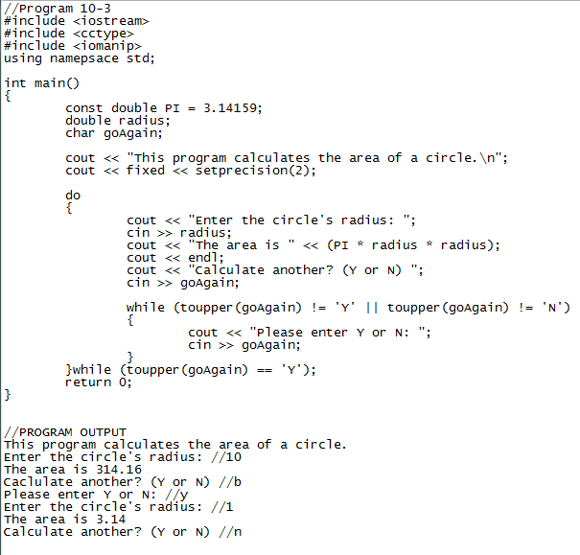

Slide 7
10.3 C-Strings
String is a generic term that describes any consecutive sequence of characters: words, sentences, names, etc.
A C-String is a string whose characters are stored in consecutive memory locations and are followed by a null terminator or null character (a byte holding ASCII value 0)
Called C-Strings because this is how strings are stored in C language
\0 is the null terminator, representing ASCII code 0, without it we would never know the length of a C-String
In C++, all string literals are stored as C-Strings. Ex: “Bailey”
B | a | I | l | e | y | \0

Slide 8
More About String Literals
A string literal or constant is defined inside two double quotation marks: “Hello my name is Robert”
This would be stored in memory as a C-String as follows:
A string literal has its own storage location just like a variable or an array
When a string literal appears in a statement, we are actually using its address
cout << “Hello there”; //the starting address of the literal is passed to cout and then cout displays consecutive characters until the null terminator
H | e | l | l | o |  | m | y |  | n | a | m
e |  | i | s |  | R | o | b | e | r | t | \0

Slide 9
C-Strings Stored in Arrays
The C language does not provide a string class like C++ does
When a program wants to create a string in memory, he or she has to create a char array large enough to hold the string plus one element for the null terminator
Important for those learning C++ because
The string class has not always existed, you might encounter older C++ code ( aka legacy code) that uses C-Strings
Some of the C++ library functions work only with C-Strings, Ex: the open member function for filestream objects only accepts C-Strings
In work, it is not unusual for C++ programmers to work with specialized libraries that deal with C, strings in C will be C-Strings
We create a char array to hold a string, plus one for the null terminator const int SIZE = 21; char names[SIZE] = “Jasmine”; //this array can only hold a string with 20 characters
This will create an array of size 21 with 8 characters: j, a, s, m, i, n, e, \0
We can also implicitly size an array: char names[] = “Jasmine”;

Slide 10
C-String input can be performed with the cin object
This allows a user to enter a string (no whitespace characters) into an array const int SIZE = 21; char name[SIZE]; cin >> name;
Since using the name of the array without braces and subscripts indicates the starting address of the array, name indicates the starting address where the string can be stored
We can prevent accepting strings that write past the limits of the array by using the getline function
const int SIZE = 80; char line[SIZE]; cin.getline(line, SIZE);
getline retrieves a full line of text, including whitespaces. line indicates the starting address of the array where input will be stored. SIZE indicates the maximum length of the string including the null terminator
Since SIZE = 80, cin will read up to 79 characters or until the user presses [ENTER], cin will then automatically append the null terminator to the end of the string
Once a string is stored as an array, it can be processed using standard subscript notation

Slide 11
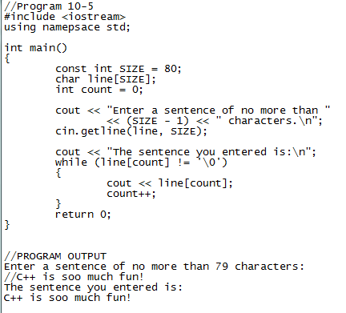

Slide 12
10.4 Library Functions for Working with C-Strings
There are many functions we can use to perform tests and manipulate C-Strings with C++
Need header file cstring

Slide 13
The strlen Function
We can use this function to determine the length of the string stored in an array:
char name[] = “Thomas Edison”; int length; length = strlen(name);
strlen accepts a pointer to a C-String as its argument, it return the length of a string, which is the number of characters up to, but not including, the null terminator
The length of the string is not to be confused with the size of the array holding it
When using a C-String handling function, you must pass one or more C-Strings as arguments, this means passing the address of the C-String, which may be accomplished by using any of the following as arguments:
The name of the array holding the C-String
A pointer variable that holds the address of the C-String
A literal string
length = strlen(“Thomas Edison”);

Slide 14
The strcat Function
This function accepts two pointers to C-Strings as its arguments, the function concatenates or appends one string to another
const int SIZE = 13; char string1[SIZE] = “Hello “; char string2[SIZE] = “World!”; cout << string1 << endl << string2 << endl; strcat(string1, string2); cout << string1 << endl;
Displays: Hello World! Hello World!
The strcat function copies the contents of string2 and adds it to the end of string1, string1 is altered but string2 is not
strcat doesn’t insert spaces, so it is the programmers job to use proper spacing in literals and string definitions
Also programmers job to make sure the array containing string1 is large enough to contain string1 + string2, otherwise strcat will overflow the array boundaries (not good)
if (sizeof(string1) >= (strlen(string1) + strlen(string2) +1)) strcat(string1, string2); else cout << “String1 is not large enough.”;

Slide 15
The strcpy Function
This function copies one C-String to another
Takes two C-String address arguments, first is usually an array
const int SIZE = 10; char string1[SIZE] = “Hello”, string2[SIZE] = “World!”; cout << string1 << endl; cout << string2 << endl; strcpy(string1, string2); cout << string1 << “ “ << string2 << endl;
Hello World! World! World!
Does not perform bounds checking, can cause unsafe memory allocation

Slide 16
The strncat and strncpy Functions
The strncat function works just like strcat except takes a third argument specifying the max number of characters from the second string to append to the first
int maxChars; const int SIZE_1 = 17; const int SIZE_2 = 18; char string1[SIZE_1] = “Welcome “; char string2[SIZE_2] = “to North Carolina”; cout << string1 << endl << string2 << endl; maxChars = sizeof(string1) – (strlen(string1) +1); //number of empty elements in string1 strncar(string1, string2, maxChars); //length of string plus one for null term. cout << string1 << endl;
Welcome to North Carolina Welcome to North

Slide 17
strncpy allows to copy a specified number of characters from a string to a destination
int maxChars; const int SIZE = 11; char string1[SIZE]; char string2[] = “I love C++ programming!”; maxChars = sizeof(string1) – 1; //maxChars = 11 – 1 = 10 strncpy(string1, string2, maxChars); //put null terminator at the end string1[maxChars] = ‘\0’; //we do this incase maxChars was less than length cout << string1 << endl; //of string2, make last element null term.
I love C++

Slide 18
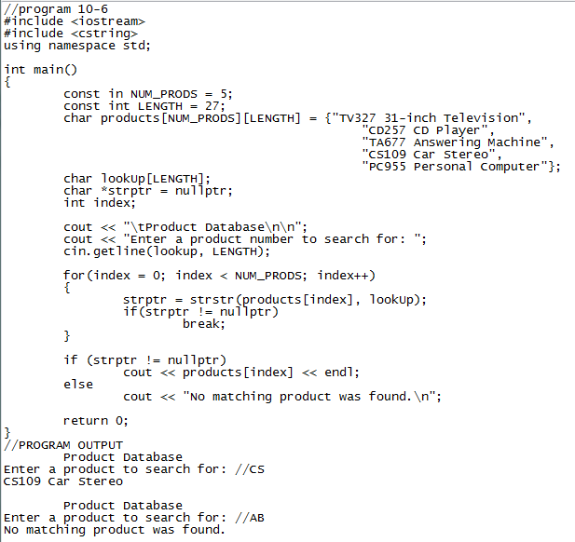
The strstr Function
Allows us to search for strings within a string
First argument is the string to be searched, second argument is the string to look for
Returns the address of the occurrence of the second string within the first string, if found, otherwise returns nullptr (address 0)

Slide 19
The strcmp Function
Since C-Strings are stored in char arrays, we cannot use relational operators to compare them
We use the strcmp function taking two C-String arguments and returns an integer indicating how the relate to one another: strcmp(string1, string2); //names of arrays are their addresses
returns zero if the two strings are equal character by character
returns a negative int if string1 comes before string2 in alphabetical order
returns a positive int if string1 comes after string2 in alphabetical order
Case sensitive

Slide 20
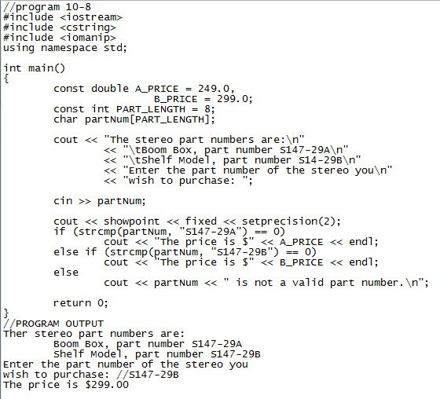

Slide 21
Using ! with strcmp
Since 0 is considered logically false, we can use the negation operator to evaluate that to true
These two statements perform the same operation
if(strcmp(firststring, secondstring) == 0)
if(!strcmp(firststring, secondstring))
if(strcmp(firststring, secondstring)) blah blah else blah blah
This will execute the else if the strings are equal since returning zero makes the condition false

Slide 22
Sorting Strings
We can use strcmp to sort two strings alphabetically based off of the integer value that is returned by the function

Slide 23
10.5 C-String/Numeric Conversion Functions
Require the header file cstdlib
Functions | Description
atoi | Accepts a C-string as an argument. Function converts the C-string to an integer and returns that value int num = atoi(“4569”);
atol | Accepts a C-string as an argument. Function converts the C-string to a long integer and returns that value. long lnum = atol(“500000000”);
atof | Accepts a C-string as an argument. Function converts the C-string to a double and returns that value double fnum = atof(“34.98”);
Passing an incorrect value as an argument can give unknown results. atoi(“123x4”) may return 123 or may return 0 or who knows

Slide 24
The to_string Function
The to_string() function converts numeric values into a string object
aka we transfer numbers that we can mathematically manipulate into text that is read-only
int number = 99; string output = to_string(number);

Slide 25
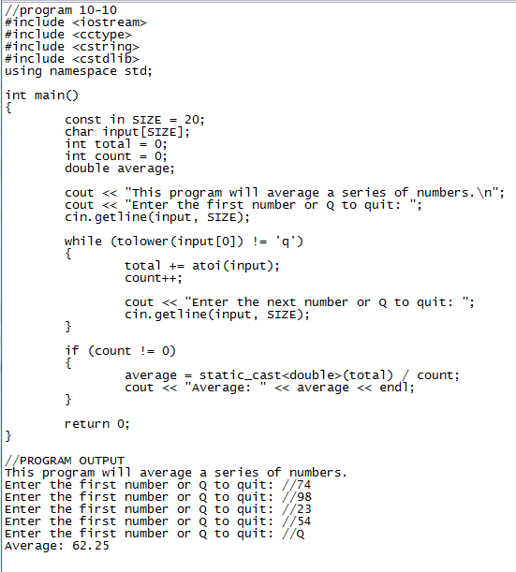

Slide 26
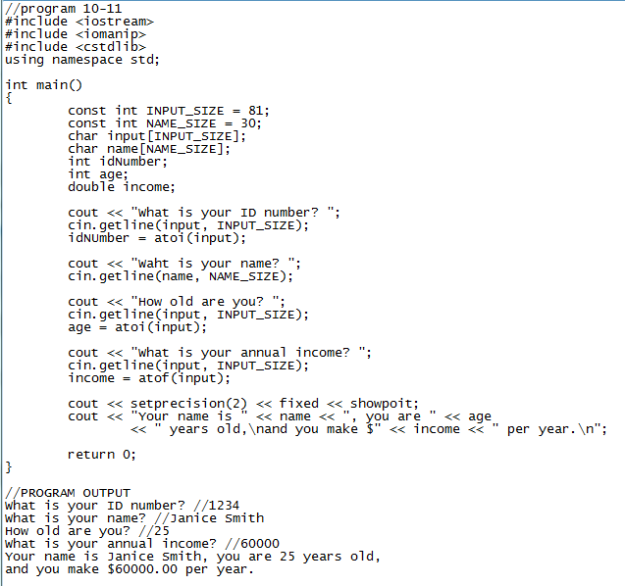

Slide 27
Lets make our own C-String handling functions
Create a project in Visual Studio
Have a function that compares two C-Strings (similar to strcmp)
Have a function that copies one string to another string (strcpy)
Have a function that returns a persons first name only
I enter Bobby Loneker to the system, this function should cut my last name off
Have a function that returns a C-string backwards
I enter Bobby to the system it returns: ybboB

Slide 28
10.7 More About the C++ string Class
We have used strings significantly at this point, we can obtain them much like normal variables with cin and output them with cout
string is not a data type, but a class, that is why a string is an object of the string class…this allows more powerful member functions to be used
We can read a line of text to a string using the getline function (takes into account the blank spaces)
string name; cout << “What is your name? “; getline(cin, name);
string objects can be compared to one another and other C-Strings via relational operators much like numeric values
similar to C-Strings, string objects can be sorted

Slide 29
Other ways to Define string Objects
Definition | Description
string address; | Defines an empty string object named address
string name(“William Smith”); | Defines a string object named name, initialized with “William Smith”
string person1(person2); | Defines a string object named person1, which is a copy of person2. person2 may be either a string object or character array
string set1(set2, 5); | Defines a string object named set1, which is initialized to the first five characters in the character array set2
string lineFull(‘z’, 10); | Defines a string object named lineFull initialized with 10 ‘z’ characters
string firstName(fullName, 0, 7); | Defines a string object named firstName, initialized with a substring of the string fullName. The substring is seven characters long, beginning at position 0.

Slide 30
Supported Operator | Description
>> | Extracts characters from a stream and inserts them into the string. Characters are copied until a whitespace or the end of the string is encountered
<< | Inserts the string into a stream
= | Assigns the string on the right to the string object on the left
+= | Appends a copy of the string on the right to the string object on the left
+ | Returns a string that is the concatenation of the two string operands
[ ] | Implements array subscript notation, as in name[x]. A reference to the character in the x position is returned
Relational Operators | Each of the R.O. are implemented

Slide 31
Using string Class Member Functions
Member Function | Description
mystring.append(n, ‘z’); | Appends n copies of ‘z’ to mystring
mystring.append(str); | Appends str to mystring
mystring.append(str, n); | Appends the first n characters of the character array str to mystring
mystring.append(str, x, n); | n number of characters from str, starting at position x, are appended to mystring. If mystring is too small, the function will copy as many characters as possible
mystring.assign(n, ‘z’); | Assigns n copies of ‘z’ to mystring
mystring.assign(str); | Assigns str to mystring. str can be a string object or char array
mystring.assign(str, n); | The first n characters of the character array str are assigned to mystring
mystring.assign(str, x, n); | n number of character from str, starting at position x, are assigned to mystring. If mystring is too small, the function will copy as many characters as possible.
mystring.at(x); | Returns the character position x in the string.
mystring.back(); | Returns the last character in the string
mystring.begin(); | Returns an iterator pointing to the first character in the string
mystring.c_str(); | Converts the contents of mystring to a C-string, and returns a pointer to the C-string
mystring.capacity(); | Returns the size of the storage allocated for the string
mystring.clear(); | Clears the string by deleting all the characters stored in it
mystring.compare(str); | Performs a comparison like the strcmp function, with the same return values

Slide 32
mystring.compare(x, n, str); | Compares mystring and str, starting at position x, and continuing for n characters. The return value is like strcmp
mystring.copy(str, x, n); | Copies the character array str to mystring, beginning at position x, for n character. If mystring is too small, the function will copy as many characters as possible
mystring.empty(); | Returns true if mystring is empty
mystring.end(); | Returns an iterator pointing to the last character of the string in mysting
mystring.erase(x, n); | Erases n characters from mystring, beginning at position x
mystring.find(‘z’, x); | Returns the first position at or beyond position x where the string str is found in mystring. str can be string object or char array
mystring.front(); | Returns the first character in the string
mystring.insert(x, n, ‘z’); | Inserts ‘z’ n times into mystring at position x
mystring.insert(x, str); | Inserts a copy of str into mystring, beginning at position x. str either string object or char array
mystring.length(); | Returns the length of the string in mystring
mystring.replace(x, n, ‘z’); | Replaces the n characters in mystring beginning at position x with the characters in string object str
mystring.resize(n, ‘z’); | Changes the size of the allocation in mystring to n. If n is less than the current size of the string, the stirng is truncated to n characters. If n is greater, the string is expanded and ‘z’ is appended at the end enough times to fill the new spaces.
mystring.size(); | Returns the length of the string in mystring
mystring.substr(x, n); | Returns a copy of a substring. The substring is n characters long and begins at position x of mystring
mystring.swap(str); | Swaps the contents of mystring with str

Slide 33
Let’s go ahead and try some of these member functions out in a program
KEY FUNCTIONS TO KNOW: .append(), .back(), .clear(), .empty(), .insert(), .length(), .substr()

